Slide 1
Laava-ID Blockchain Project
COMP6452 Software Architecture for Blockchain Applications
Qinghua Lu
| Senior Research Scientist @ AAP team, CSIRO Data61
| Qinghua.Lu@data61.csiro.au

Slide 2
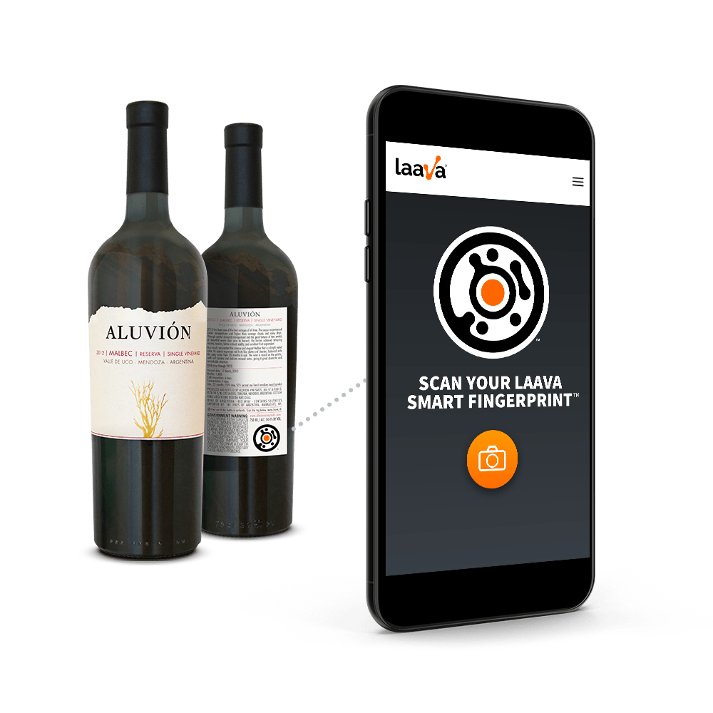
Background
Laava: item tracking service provider
A novel type of unique ID for individual item tracking
Two phases
Phase 1: simple blockchain solution
Phase 2: focus on scalability, data privacy
2 |

Slide 3
Laava-ID Blockchain Project Phase 1
COMP6452 Software Architecture for Blockchain Applications

Slide 4
Project Aim and Overall Process
Developing a PoC for the Laava-ID Platform MVP
A tag registration system on blockchain
Allow any individual thing to be authenticated easily and securely
Investigate the use of blockchain to enable read/write interactions/transactions on a public blockchain
Development Process
Requirement identification
Design alternatives and evaluation
Architecture design and on-chain data structure design
Implementation and testing
4 |

Slide 5
Stakeholders
Laava-ID
Platform MVP owner
Clients
Companies which buy tags from Laava-ID and register them on blockchain for their products
End consumers
Who has the Laava-ID application to track the tag scan history and bought the products from clients
Supply chain participants
Include carriers, abattoir, farmers, etc
5 |

Slide 6
Functional Requirements
Id | Requirement Description | Priority | Dependencies
F1 | Ability to register a tag on the blockchain | Critical
F2 | Ability to store additional public product tag data that might be visible by the public depending on the client needs. | Critical | F1
F3 | Ability to reduce costs by using a batching system when tag creation. | Desired | F1, F2
F4 | Ability to read/query back the data programmatically | Critical | F1, F2
F5 | Ability to get the location address of the data on blockchain and stored it in Laava-ID database for later retrieval | Essential | F1, F2
F6 | Ability to confirm that the tag has been added to the Blockchain successfully | Essential | F1
F7 | Smart contract access control. | Essential | F1, F2
6 |

Slide 7
Non-Functional Requirements
Integrity
The tag data, metadata, and event data cannot be changed by anyone.
Availability
There should be high likelihood of being able to access the tag registry when desired
Read latency
End consumers may need to repeatedly query the tag registry while browsing and searching for relevant datasets.
7 |

Slide 8
Design Alternatives (1/2)- Centralised Architecture
8 |

Slide 9
Design Alternatives (2/2)- Decentralised Architecture
9 |

Slide 10
Evaluation of Design Alternatives
Integrity
Design 1: relies on Laava to create registry entries and host the platform in a centralised location.
Design 2: registry entries can only be created by the data providers, using their private keys. All transactions are validated by all processing nodes in the blockchain network. Data consumers hold a local copy of the blockchain, which removes a possible point of manipulation.
Availability
Design 1: hosted in a centralised location which is a single point of failure for tag registry availability for all stakeholders.
Design 2: the use of a public blockchain allows increased data redundancy which can improve availability for data consumers.
Read latency
Design 1: reading is performed through a remote API over the internet,
Design 2: a blockchain local node is collocated with the consumer’s query interface, and reading is done locally
10 |

Slide 11
System Architecture
11 |

Slide 12
On-Chain Data Structure
12 |

Slide 13
Laava-ID Blockchain Project Phase 2
COMP6452 Software Architecture for Blockchain Applications

Slide 14
Motivation
Multi-tenant blockchain-based systems
A single system often serves multiple tenants
E.g., a traceability system
Architecture design is challenging
Data privacy
Tenants must not be able to read other tenants’ data
Scalability
Some tenants might store large amounts of data
There might be hundreds of tenants in one system
Performance isolation
Tenants with higher workload should not affect other tenants
14 |

Slide 15
Requirements
Functional Requirements
FR1 – Only selected tenants are able to write data on chain
FR2 – Tenants need to be able to write batches of data on chain
FR3 – End users need to be able to view the entire history
FR4 – End users need to be able to validate the identity of tenant
FR5 – Independent agencies need to be able to access data for auditing
FR6 – Each tenant is able to serve their end users
Non-Functional Requirements
NFR1 – Data integrity of on-chain data
NFR2 – Scalability within each tenant and in the number of tenants
NFR3 – Data Privacy
NFR4 – Performance Isolation
NFR5 – Availability
15 |

Slide 16
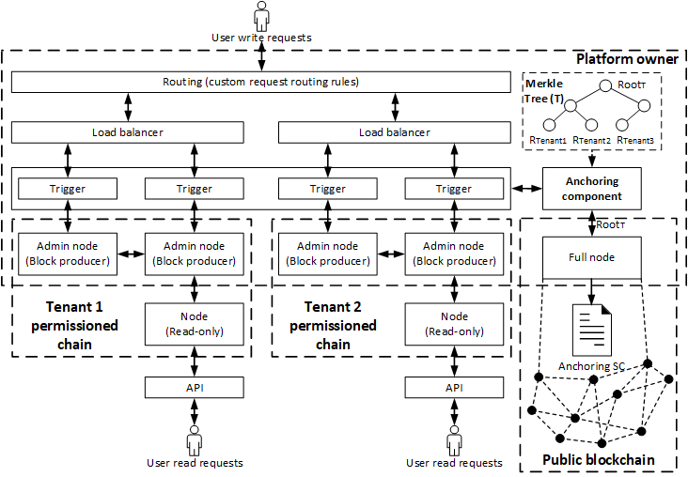
Design Alternative (3/3)
16 |

Slide 17
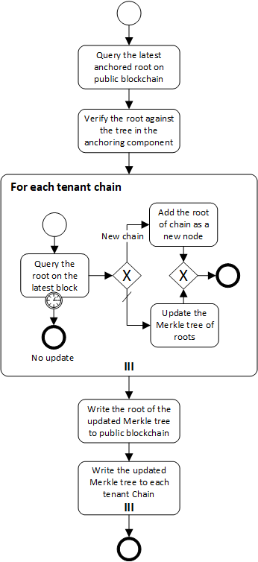
Anchoring
Query the latest anchored root and verify it
For each tenant
Query the root on the latest block
If the chain is in the tree of roots, update the value
If not, add as new node
Write the root to public chain and store the tree on tenant chains
17 |

Slide 18
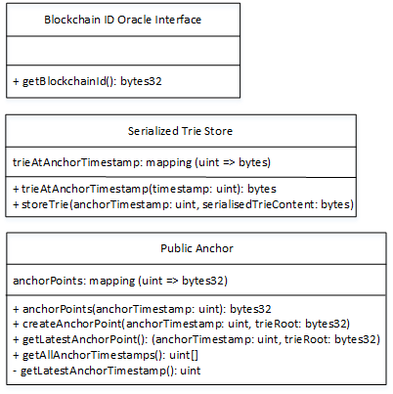
Implementation
Lorikeet: our model-driven engineering tool for smart contract generation
18 |

Slide 19
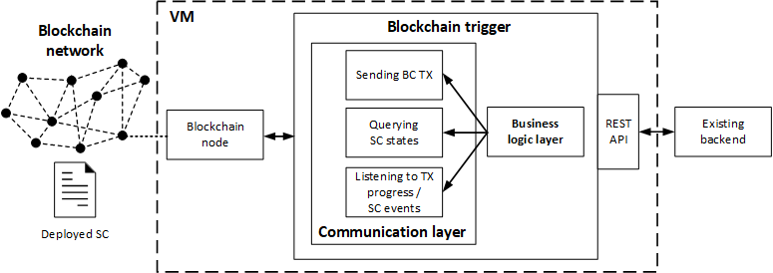
Design Alternative (1/3)

Slide 20
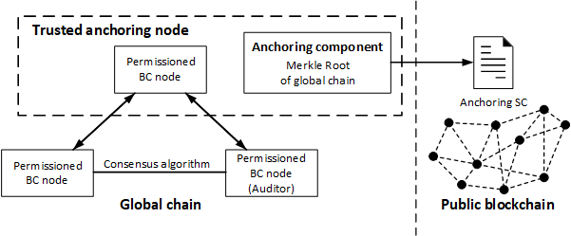
Design Alternative (2/3)

Slide 21
Qualitative Analysis
Data Integrity-achieved by all three design alternatives
Design 1: each tenant hosts a copy of public blockchain
Design 2 and 3: anchoring to public blockchain
21 |

Slide 22
Qualitative Analysis
Cost
Design 2 and 3 are designed in a way that anchors to public blockchain
Cost for anchoring is fixed
Infrastructure cost
22 |

Slide 23
Qualitative Analysis
Data Privacy
Design 1 and 2: data encryption
Design 3: run on separate VPCs
23 |

Slide 24
Qualitative Analysis
Performance Isolation
Design 1 and 2: might affect
Design 3: not affect
24 |

Slide 25
Qualitative Analysis
Availability
Design 1: public blockchain-high availability
Design 2 & 3: adding full nodes and block producers
25 |

Slide 26
Qualitative Analysis
Configuration Flexibility
Design 1: low flexibility
Design 2 & 3: flexible
26 |

Slide 27
Quantitative Analysis
Test 1
Test 2
Test 3
Test 4
27 |

Slide 28
Thank You
Ingo Weber, Qinghua Lu, An Binh Tran, Amit Deshmukh, Marek Górski, Markus Strazds: A Platform Architecture for Multi-Tenant Blockchain-Based Systems. ICSA 2019: 101-110
Qinghua Lu| Senior Research Scientist
Architecture & Analytics Platforms (AAP) team
T +61 2 9490 5855
E Qinghua.Lu@data61.csiro.au
W www.data61.csiro.au/

